Slide 1
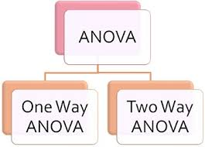
Week 17: Two-Way ANOVA

Slide 2
Learning Objectives of this topic
State hypotheses;
Distinguish between main and interaction effects;
Know difference between ANOVA with and without replications;
Interpret test results.

Slide 3
Two-Way ANOVA
In a Two-way ANOVA, the effects of two categorical factors can be investigated simultaneously.
Two-way ANOVA permits the investigation of the effects of either factor alone (e.g. the effect of brand of car on the gas mileage, and the effect of the condition on the gas mileage) and also the two factors together (e.g. the combined effect of the model of the car and the effect of condition on gas mileage).

Slide 4


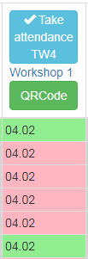
Few publications using Two-way ANOVA
The effects of camera lenses and dental specialties on the perception of smile esthetics (Sajjadi et al, 2016)
A comparison between psychological and economic factors affecting individual investor’s decision-making behavior (Sarwar & Afaf, 2016)
Impact of Attendance on Performance of Students
Using ANOVA (Kaur et al, 2010)

Slide 5



Logic of Two-Way ANOVA
SSTotal
SS between
SSwithin
SS factorA
SS factorB
SS interaction

Slide 6
Two-Way ANOVA
We need to test for the independent and combined effects of multiple factors on performance. We do this with an ANOVA that asks:
  (i) how different from each other are the means for levels of Factor A?
  (ii) how different from each other are the means for levels of Factor B?
  (iii) how different from each other are the means for the factorial combinations produced by A and B together?

Slide 7
Assumptions for Two-Way ANOVA
Observations within each sample are independent.
Populations are approximately normally distributed.
Populations have equal variances (homogeneity of variance).
The groups must have the same sample size.

Slide 8
Two-Way ANOVA
The first two of those questions are questions about main effects of the respective independent variables.
The third question is about the interaction effect, the effect of the two variables considered simultaneously. Two factors A and B are said to interact if the difference in mean responses for two levels of one factor is not constant across levels of the second factor.

Slide 9
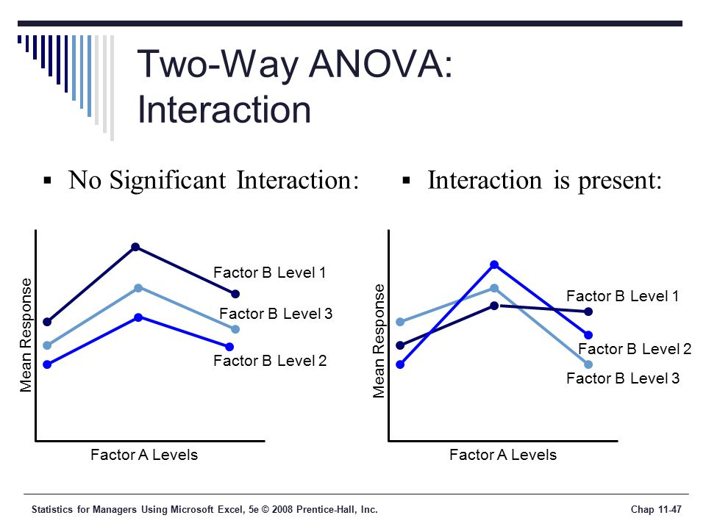

Slide 10
Two-Way ANOVA
Column Treatment or Factor B
Row
Treatment
Or
Factor A
.
.
Cells
.
.
.
.
.
.
.
.
.
.
.
.
.
.
.

Slide 11
Two-Way ANOVA
2 x 2 ANOVA with replication
2 x 2 ANOVA without replication
Factor B
Factor B
 | Level 1 | Level 2
Level 1 | Group 1 | Group 2
Level 2 | Group 3 | Group 4
 | Level 1 | Level 2
Level 1 | Subj. 1,2...r | Subj. 1,2...r
Level 2 | Subj. 1,2...r | Subj. 1,2...r
Factor A
Factor A
Treatment

Slide 12
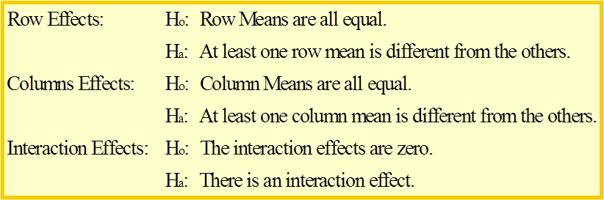
Two-Way ANOVA
There are three hypotheses associated with Two-Way Anova with replication:

Slide 13
Two-Way ANOVA
There are two hypotheses associated with Two-Way Anova without replication:

Slide 14
Two-Way ANOVA with replication
Source | Sum of Squares | df | Mean Square | F
Factor A | SSA | a-1 | MSA = SSA/df_{A} | MSA/MSE
Factor B | SSB | b-1 | MSB = SSB/df_{B} | MSB/MSE
Interaction (AB) | SSAB | (a-1)(b-1) | MSAB = SSAB/df_{AB} | MSAB/MSE
Error | SSE | ab(r-1) | MSE = SSE/df_{E}
Total | TSS | abr-1
r - replications

Slide 15
Two-Way ANOVA
Making conclusions based on test results.
Start from interaction effect:
1. If there is significant interaction, do not make conclusions on main effects. Because some part of significance of Factor A might be due to dependence on Factor B.
2. If there is no interaction, then one can make conclusions on main effects.

Slide 16
Two-Way ANOVA without replication
Source | Sum of Squares | df | Mean Square | F
Factor A | SSA | a-1 | MSA = SSA/df_{A} | MSA/MSE
Factor B | SSB | b-1 | MSB = SSB/df_{B} | MSB/MSE
Error | SSE | (a-1)(b-1) | MSE = SSE/df_{E}
Total | TSS | ab-1

Slide 17


The Effect of a Limited Time Offer on Purchase Intent
Starbucks’ Pumpkin Spice Latte (PSL) is the company’s most popular seasonal item. Why is this? Is it the unique flavor? Or could it be because it is available for only a limited time each year? To investigate this, some students surveyed 12 Starbucks consumers about their intent to purchase a PSL when it is offered in the fall. Half of the surveys included the upcoming PSL advertisement. The other half included the same advertisement with the additional words “Limited Time Offer” above the image of the drink.
Because purchase intent may depend on how frequently a consumer visits Starbucks, the students included a survey question about this. The question was used to classify each customer as either a “light” or “heavy” consumer of Starbucks. The students then analyzed these data using a two-way ANOVA.

Slide 18
Table. Purchase Intent Study
Based on the given promotion, how likely are you to purchase the Pumpkin Spice Latte in the near future?
Very Unlikely 1 2 3 4 5 6 7 Very Likely
 | Consumer Status
Advertisement | Light | Heavy
Regular | 4 | 5
 | 5 | 6
 | 4 | 5
Added wording | 5 | 5
 | 6 | 7
 | 6 | 6

Slide 19
Hypotheses:
1) Factor A (Advertisement)
H₀: Advertisement type has no effect on purchase intent.
Ha: Advertisement type has significant effect on purchase intent.
2) Factor B (Consumer Status)
H₀: Consumer status has no effect on purchase intent.
Ha: Consumer status has significant effect on purchase intent.
3) Factor AB (Interaction)
H₀: There is no interaction between Advertisement and Consumer Status.
Ha: There is an interaction between Advertisement and Consumer Status.

Slide 20
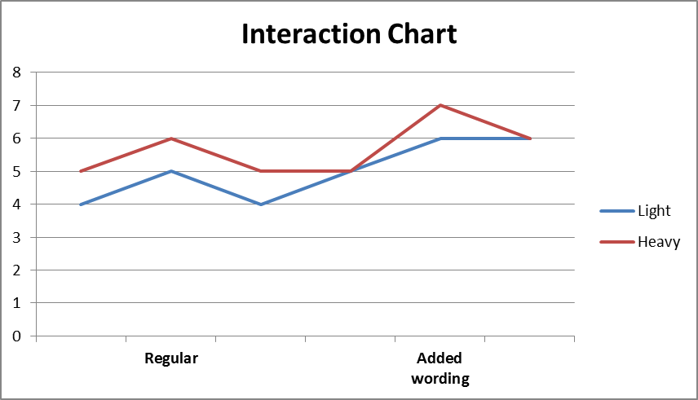

Slide 21
Excel Output (α = 0.05)
ANOVA
Source of Variation | SS | df | MS | F | P-value | F crit
Sample (Advertisement) | 3 | 1 | 3 | 6 | 0.040 | 5.318
Columns (Con. Status) | 1.333 | 1 | 1.333 | 2.667 | 0.141 | 5.318
Interaction | 0.333 | 1 | 0.333 | 0.667 | 0.439 | 5.318
Within | 4 | 8 | 0.5
Total | 8.667 | 11

Slide 22
Two-Way ANOVA
Conclusions.
Based on test results from Excel, we conclude with 95% confidence (α = 0.05) that:
There is no interaction between Advertisement and Consumer Status, which means effect of Advertisement does not vary by levels of Consumer status.
Advertisement type has significant effect on purchase intent.
Consumer status has no effect on purchase intent.

